Slide 1

Team Foundation Server
Session 2 – Source Control

Slide 2
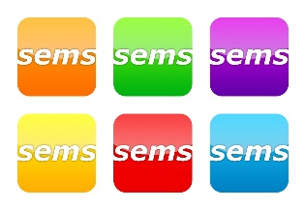

Agenda – Session 2 – Source Control
What is source control?
Why should I use source control in TFS?
Workspaces
Recommend Project Structure in Source Control
Check-in / Check-out
Branching / Merging
Shelvesets
Automated Build

Slide 3
What is source control?
Revision control, also known as version control and source control (and an aspect of software configuration management), is the management of changes to documents, computer programs, large web sites, and other collections of information.
From: http://en.wikipedia.org/wiki/Revision_control

Slide 4
Why should I use TFS? – Source Control
Benefits:
Protect Corporate IP
Backup work
Follow progress, history
Store ‘Milestones’
Reproducibility
Sharing Code
Traceability – required by some divisions
Many more …

Slide 5
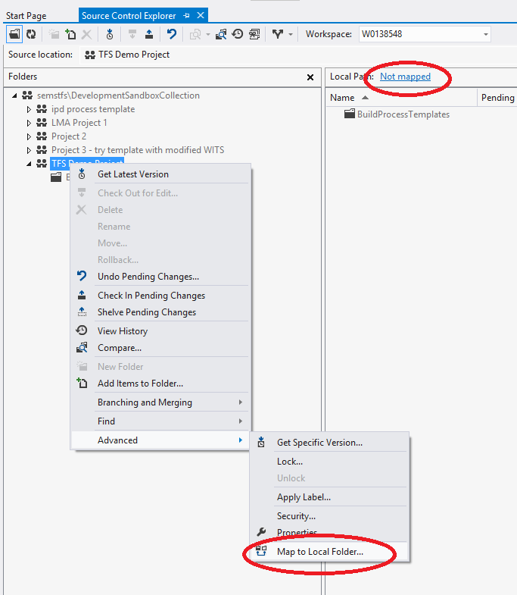
Workspaces
Map the source control folder to a local folder
Recommend mapping the top level source control folder to a short local path
$/ProjectName ➔ c:\projects\ProjectName

Slide 6
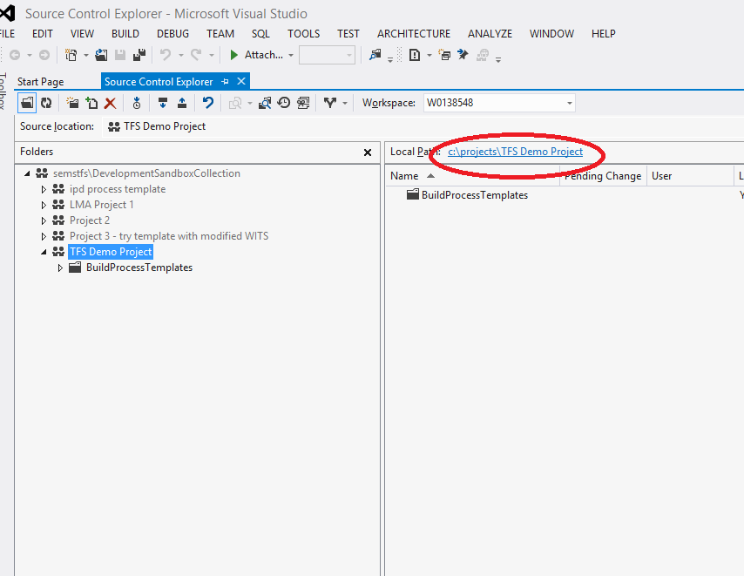
Workspaces
Map the source control folder to a local folder
Recommend mapping the top level source control folder to a short local path
$/ProjectName ➔ c:\projects\ProjectName

Slide 7
Workspaces
You can map individual folders to local folders if needed
This approach is powerful for configuration, but can be confusing for long term support
Can assign security permissions per folder – leads to confusion unless tightly managed

Slide 8
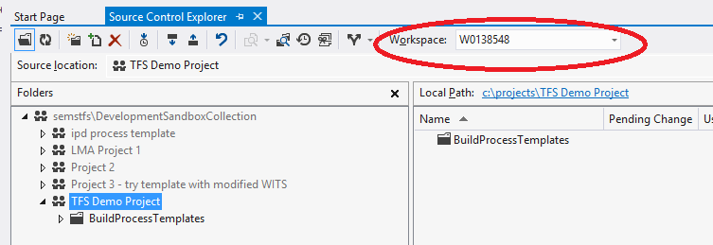
Workspaces
You can have multiple workspaces - default is your computer name
If using multiple computers, you will have multiple Workspaces – but each is computer specific. I.e., not re-usable across computers

Slide 9
Source Control – Project Structure
Promotion Model
QA
Prod
Dev

Slide 10
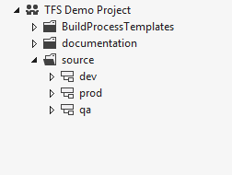
Project Structure
When setup in source control, provides a path for source code management
Demo – how to setup a new Team Project

Slide 11
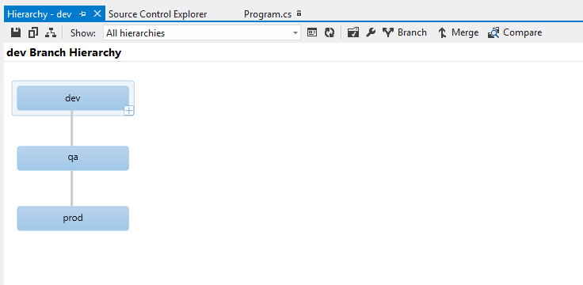
Project Structure
Tools in Visual Studio help with source code management
Enable visualization of code with tools to compare and merge
Visual Studio 2012 – new merge tool.

Slide 12
Check in & Check out
How do I get my code into TFS?
Easiest Method
create and/or copy code into working path
“add to source control”
Check in
Note: each Check-in is called a ‘Changeset’ within TFS – and assigned an Id
If you have Power Tools installed – add from Windows Explorer

Slide 13
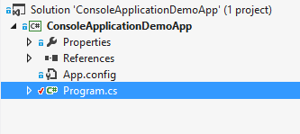
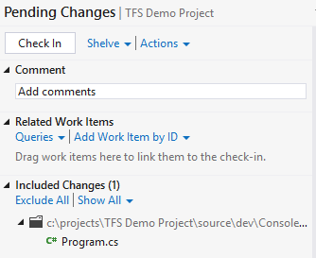
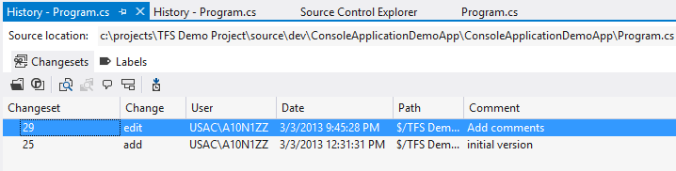
Check in & Check out
How do I get my Team’s code?
Easiest Method
Get Latest on top level folder, or on Solution
Demo: show Check in, Check out, Get Latest, Show History, Lock

Slide 14
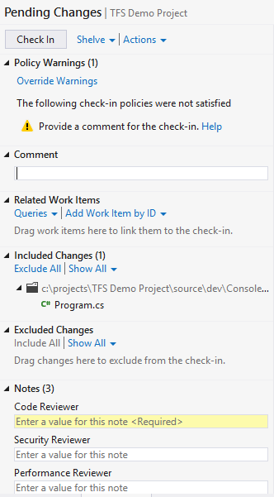
Check in & Check out
Check-in Policies - Allows the team to set norms and enforce, such as:
Check-in comments
Check-in Notes – similar – require notes at Check-in time
Demo: show Check in, Check out, Get Latest, Show History

Slide 15
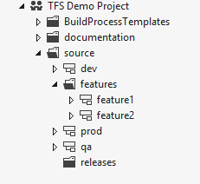
Branching / Merging
Can get complicated – keep it as simple as possible
Increased team size or <1 teams = more complicated
Merge as often as possible – keeps conflicts to minimum

Slide 16
Branching / Merging
Demo – Branching / Merging

Slide 17
Shelvesets
Shelvesets are useful when you want to stop work for:
Interruption: You have pending changes that are not ready for check in, but you need to work on a different task.
Collaboration: You have pending changes that are not ready for check in but you need to share them with another team member.
Code Review: You want another team member to perform a code review of your pending changes.
Private Build: Before you check in your changes, you can use your automated build system to build and test your code.
Backup: You have work in progress that you cannot finish now so you want a backup copy that is stored on your server and available to other team members who might need to access it.
Handoff: You have work in progress that you want to hand off to another team member.
Suspend Your Work and Manage Your Shelvesets
http://msdn.microsoft.com/en-us/library/ms181403.aspx

Slide 18
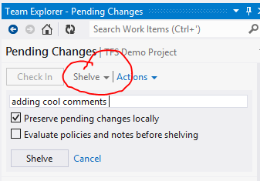
Shelvesets
Demo – Shelve a change

Slide 19
Automated Builds
Perform a build on ‘trigger’ operations, such as:
Code Check-in (Continuous Integration)
Fixed time (nightly build)
Requested (manual build)
Automated build can also run Unit Tests to ensure new code is passing automated tests
Tip: When performing an automated build, use the Workspace to only retrieve the minimum source code

Slide 20
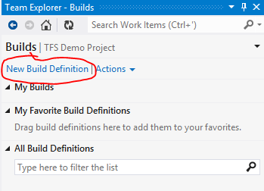
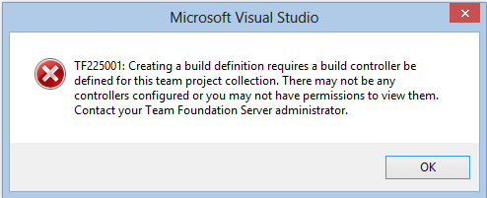
Automated Builds
Demo – define a new build
Need a build machine defined for the Project Collection

Slide 21
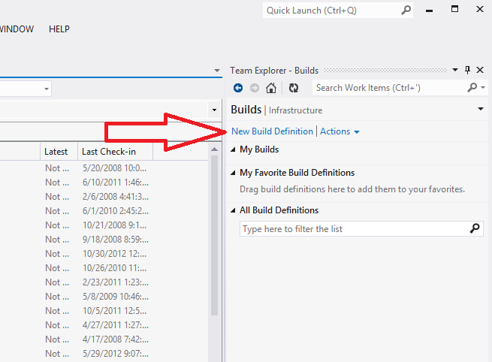
Automated Builds

Slide 22
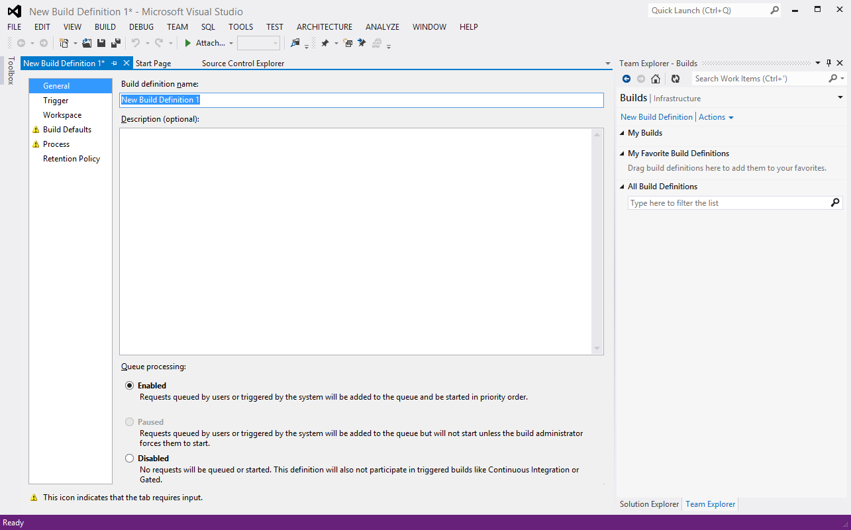
Automated Builds

Slide 23
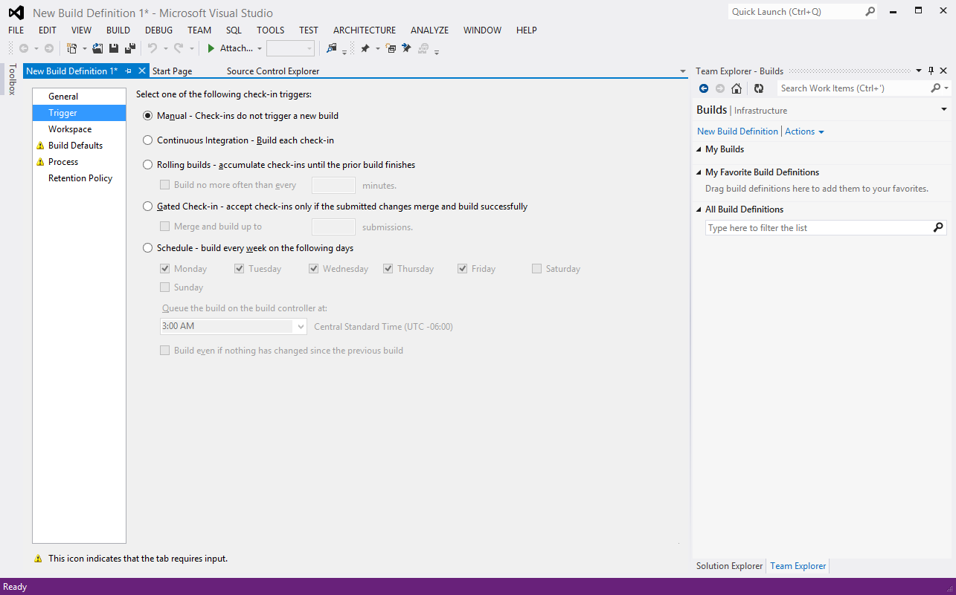
Automated Builds

Slide 24
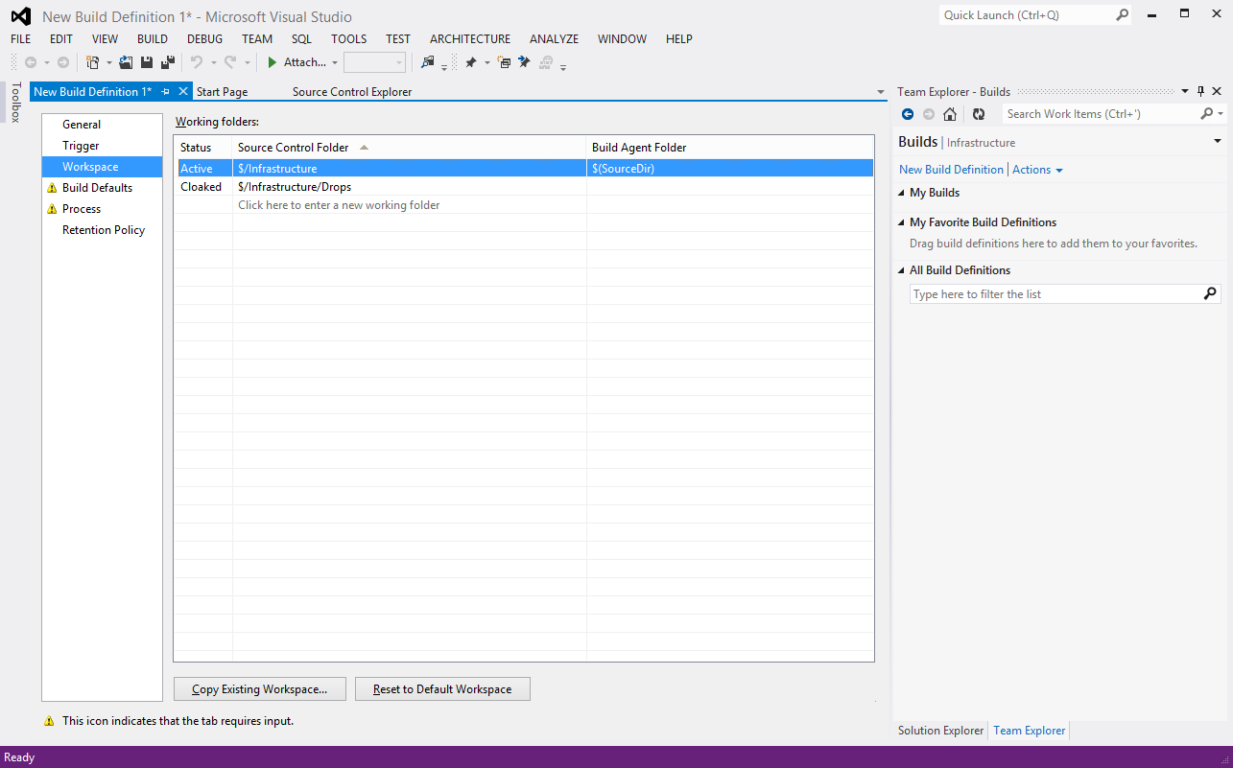
Automated Builds

Slide 25
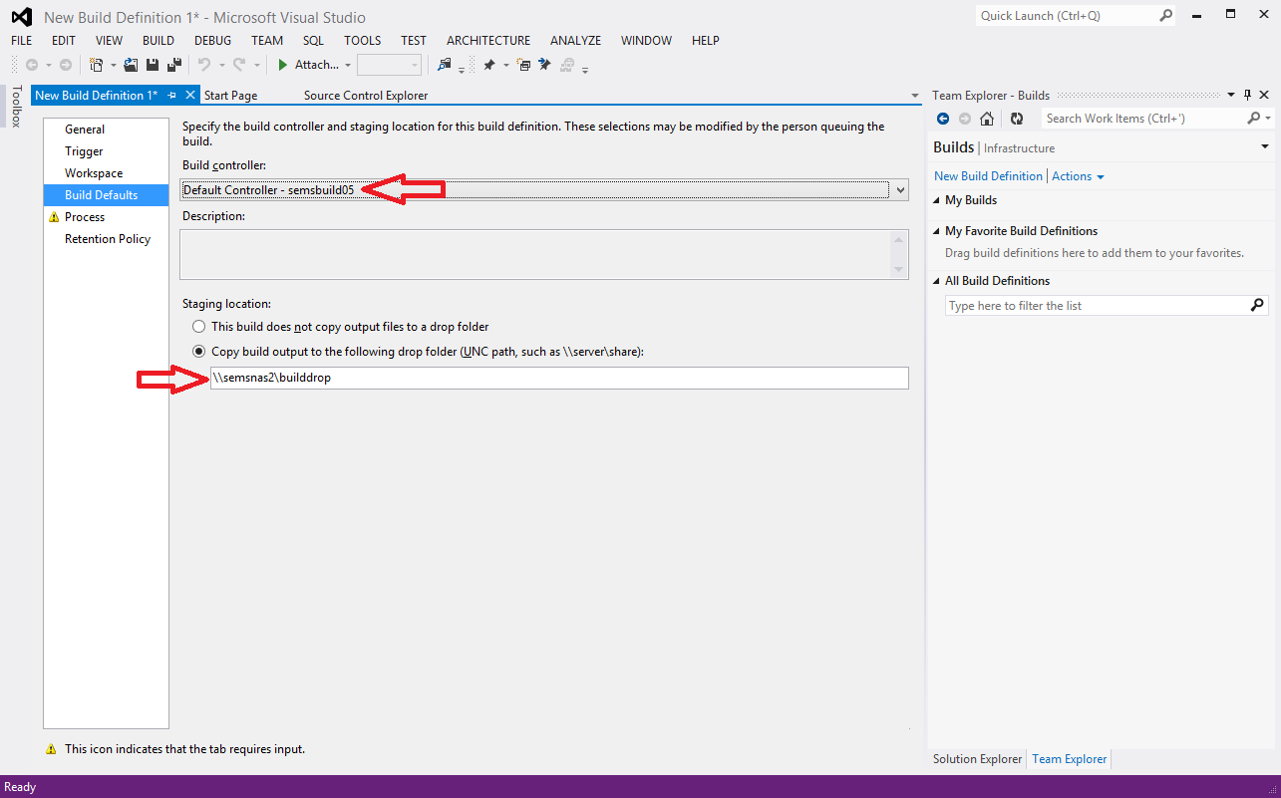
Automated Builds

Slide 26
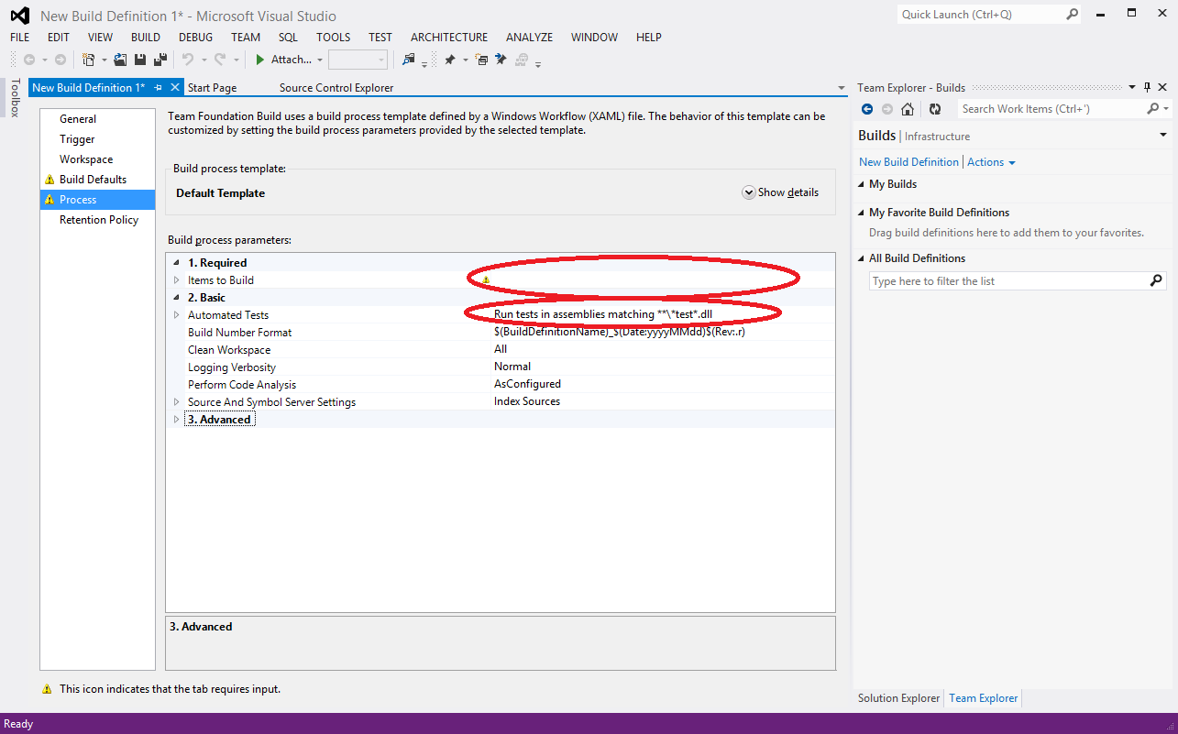
Automated Builds

Slide 27
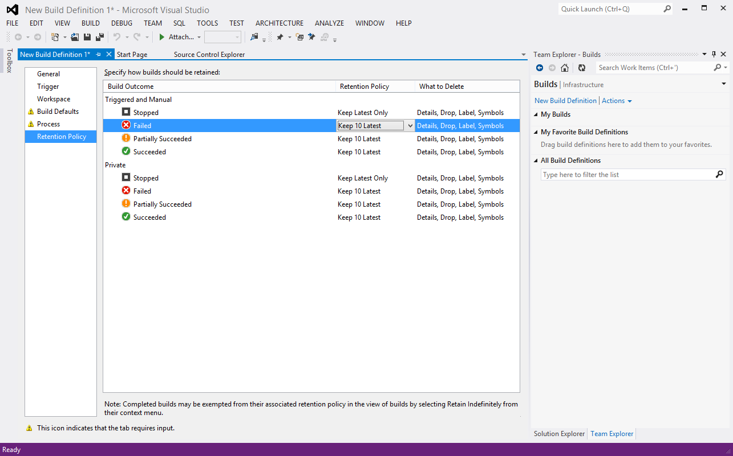
Automated Builds

Slide 28
End of Session 2 - Thank you!

Slide 29
Resources
SEMS Team Foundation Server: http://semstfs.usac.mmm.com/
Team Foundation Server - Using Version Control: http://msdn.microsoft.com/en-us/library/ms181368(VS.100).aspx
Michael E. O’Brien meobrien@mmm.com (651) 733-4652

